Slide 1
SCRUM
A better way to manage projects
Dalmo Mendonca
Certified Scrum Master

Slide 2
What do you want to hear about?

Slide 3
The Proposal
USE SCRUM METHODS
TO BETTER MANAGE
YOUR PROJECTS

Slide 4
Project
a temporary endeavor undertaken to create a unique product or service

Slide 5
Project Management
Plan
Design
Develop
Test
Release

Slide 6
Project Problems & Pitfalls
Poor Communication
Over Time
Low Quality Results
Over Budget
Unforeseen Risks
No longer needed

Slide 7
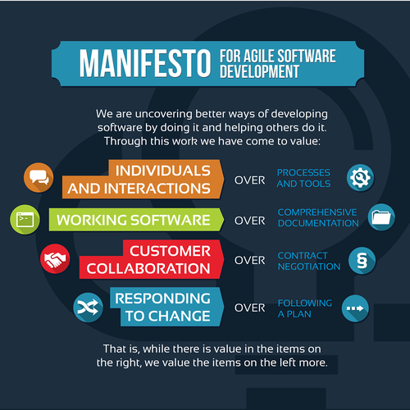
Agile (Scrum’s Parent)

Slide 8
Scrum
A light, agile framework for better project management
Simple to learn, difficult to master
Adopting even some scrum techniques = better results

Slide 9
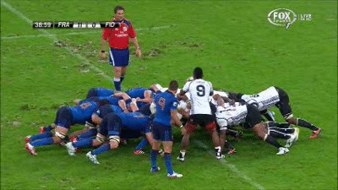
Scrum
A light, agile framework for better project management
Simple to learn, difficult to master
Adopting even some scrum techniques = better results

Slide 10
Feature #1 Cross-Functional Teams
All roles work on the project together, at the same time
Testers and Developers have input from beginning
Designers and Product Owners stay on through the end
Finance, marketing, operations, etc
Integrated, no silos
The backbone of the scrum framework

Slide 11
Feature #2 Sprints
Time-boxed initiative (protected time)
No changes to the goal of the sprint (protected scope)
1 sprint = Something you can present to the customer
May require several tasks
Led by the cross-functional team
Includes all phases of the product lifecycle
Plan, design, develop, test, release

Slide 12
Feature #3 Daily Scrum
Every team member stands up
Never more than 5 minutes
Team members answer 3 questions
What did you do yesterday?
What will you do today?
What impediments are in your way?
Scrum Master coordinates impediment removal

Slide 13
Scrum Lifecycle
dalmomendonca.com/scrum

Slide 14
Q & A

Slide 15
Remember…
USE SCRUM METHODS
TO BETTER MANAGE
YOUR PROJECTS
dalmomendonca.com/scrum

